Slide 1
Building a solar Car Team

Slide 2
So… you want to start a Solar car team?
Administration gives the approval
Many questions to be answered before taking steps to find students
Funding – Primary question to be answered
Budget- School, department, class, etc ?????
Decide on your level of participation

Slide 3
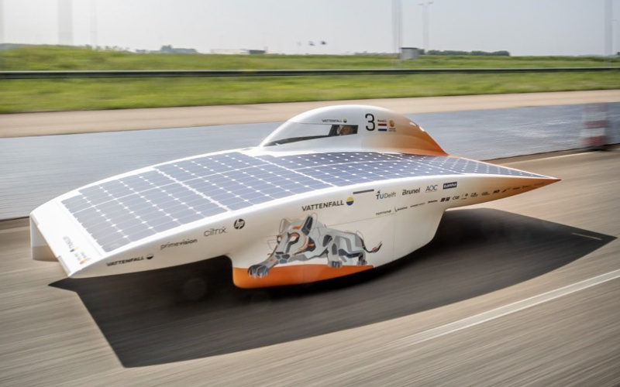
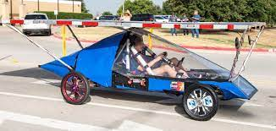
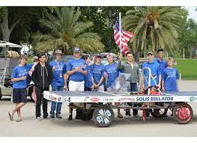
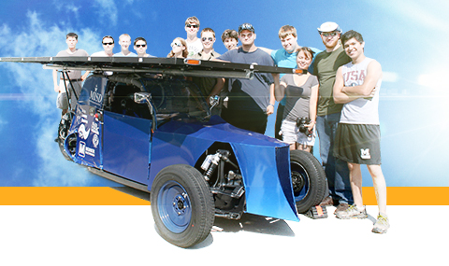
Expense has NOTHING to do with ability to win
2016
2015
$100K
Solar array
96 Volt
48 Volt
120 Volt
$5000 total

Slide 4
Finding What kind of Students
Math/Physics Class is your breeding ground
DO not count out other classes
3dimensional Spatial ability is paramount
Mechanical types
SolidWorks CAD design
Electrical types
Solidworks/CAD design
Business types
Fundraising, publicity, event planning
Be inclusive – kids learn from each other better than they learn from teachers
Students need available time
Overcommitted students are NOT helpful – ultimately killed my program

Slide 5
Be this guy

Slide 6
Once you’ve found students
Test or not to test
Application can be tied to test score (larger established programs)
“membership” fee - $______________ or NOT (excited to have you)
Students have skin in the game
Insert number here

Slide 7
How Many do I need to Find?
8 – 15 students (optimal number for team cohesiveness)
21 students largest team I’ve ever seen – A lot of disengaged and standing around
Ran 2019 race with 5 guys - not advisable

Slide 8
Once your team is taking shape
Additional Questions

Slide 9
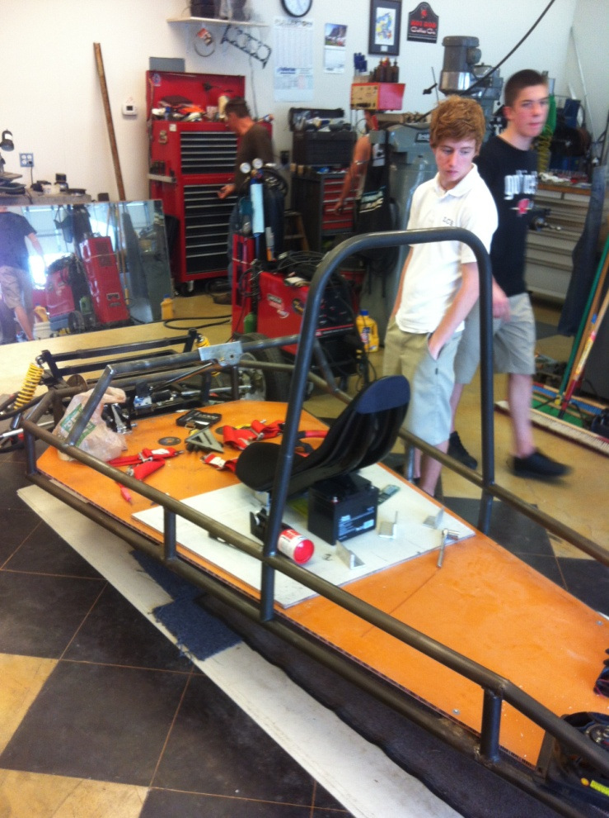
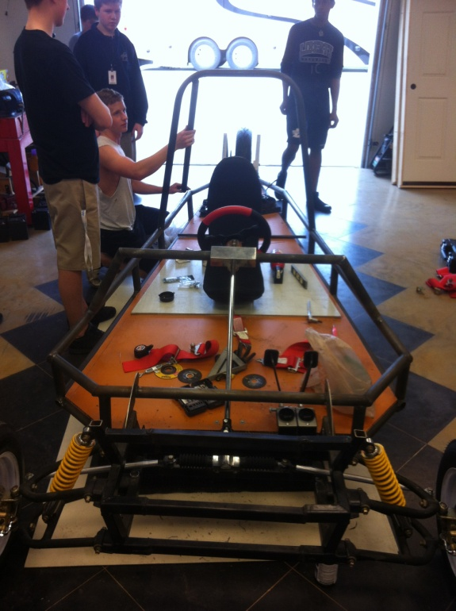
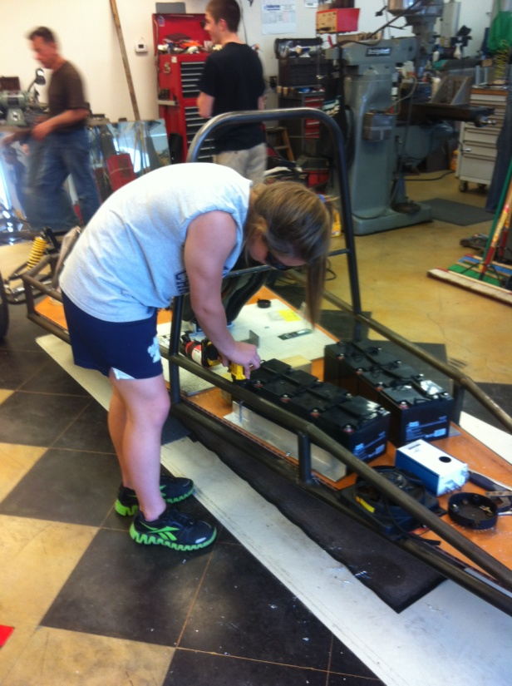
Where are you going to work
At Larry’s Shop

Slide 10
TOTOOLSTOOLSTOOLSTOOLSTOOLSTOOLSTOOLS
TOOLSTOOLSTOOLSTOOLSTOOLSTOOLSTOOLS
TOOLSTOOLSTOOLSTOOLSTOOLSTOOLSTOOLSTOOLS
TOOLSTOOLSTOOLSTOOLSTOOLSTOOLSTOOLS

Slide 11
Solar Car Attendance decides on whether they travel with the team
Attendance
Work ethic – I have asked students to not come back
Initiative – I can’t tell you everything
Hours on the car
Attendance at events – home Depot ShakeNBake (community events)

Slide 12
Foster their Passions
Let students try multiple things
Batteries
Mechanical
Trailer team – invaluable (truck, hitches, travel supplies, organization)
Telemetry team
They will let you know when something hits – Run with it

